Slide 1

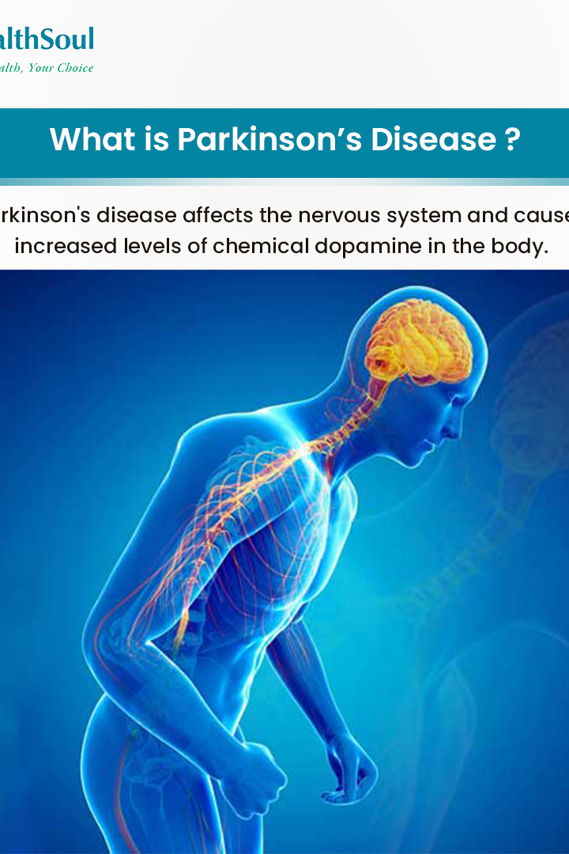
PARKINSON DISEASE DETECTION using XGBOOSTER
Parkinson's Disease Detection using the powerful XGBooster algorithm. Learn about the importance of early detection and how machine learning is revolutionizing diagnosis.
Faculty Coordinator – Mrs
Team Members :-
Anish Kumar- 1BI20AI004
Manoj Lokesh Reddy- 21BI20AI0

Slide 2

Abstract
Parkinson's Disease is a neurodegenerative disorder characterized by motor symptoms such as tremors, stiffness, and slowness of movement. It affects millions worldwide. Parkinson's disease (PD) is a progressive neurodegenerative disorder affecting millions of people worldwide. Early and accurate diagnosis of Parkinson's disease is crucial for timely intervention and improved patient outcomes. This research focuses on the development and implementation of an efficient diagnostic model for Parkinson's disease using the XGBoost algorithm, a powerful machine learning technique known for its robust performance in classification tasks.
The dataset utilized in this study includes a comprehensive set of features extracted from various clinical assessments, such as tremor amplitude, bradykinesia, and rigidity. These features serve as input variables for the XGBoost model, which is trained on a labeled dataset consisting of both PD and non-PD samples. The model's hyperparameters are fine-tuned to achieve optimal performance, balancing sensitivity and specificity in disease detection.The proposed XGBoost-based Parkinson's disease detection model demonstrates promising results in terms of accuracy, sensitivity, and specificity during the training and validation phases. To evaluate its real-world applicability, the model is further tested on an independent dataset, demonstrating its generalization capabilities.

Slide 3

Introduction
Early detection of Parkinson's Disease is crucial for timely intervention and managing symptoms effectively. It can improve the quality of life for patients.
Parkinson's Disease is caused by the loss of dopamine-producing cells in the brain. Common symptoms include tremors, rigidity, bradykinesia, and postural instability. Parkinson's Disease can significantly impact daily activities such as walking, talking, and performing routine tasks. It affects mobility, speech, and overall functionality. Introduction to the powerful XGBoost algorithm and its application in detecting Parkinson's Disease. Discover how machine learning is transforming diagnostics.
The integration of machine learning algorithms into Parkinson's disease diagnosis holds the promise of revolutionizing current practices, providing a more objective and data-driven approach. As we explore the capabilities of the XGBoost algorithm in this context, we aim to contribute to the growing body of research dedicated to advancing the field of neurodegenerative disease diagnosis and management.

Slide 4
Literature Survey
Sl.no | Authors name and year | Title name and journal Name | Abstract | Technique | Limitation
1 | Aditi Govindua , Sushila Palweb, | Early detection of Parkinson's disease using machine learning,IEEE | This paper highlights the use of machine learning techniques in telemedicine to detect PD in its early stages. | Random Forest emerges as the optimal ML technique for Parkinson's disease detection, surpassing SVM, KNN, and Logistic Regression in classification results. | The study is based on a relatively small dataset consisting of audio data from only 30 individuals with Parkinson's disease and healthy subjects.
2 | Mohammed Younis Thanoun, MOHAMMAD T. YASEEN,2022 Feb | A Comparative Study of Parkinson Disease Diagnosis in Machine Learning ,ICAAI | Parkinson's disease (PD) is a cumulative disorder in the nervous system. PD patients may experience difficulty in movement and speaking due to damages in certain parts in the brain | In this study, we propose using two types of Ensemble learning methods Stacking Classifier and voting classifier, which are potential methods of PD detection using machine learning. | Relying solely on MDVP audio data may limit the analysis; future work should explore integrating REM sleep data for a more comprehensive understanding of Parkinson's disease.
3 | Raya Alshammri, ,Ghaida Alharbi, Ebtisam Alharbi, Ibrahim Almubark | Machine learning approaches to identify Parkinson's disease,FAI | In this study, we leverage machine learning methodologies to discern Parkinson's disease, with Random Forest proving superior to SVM, KNN, and Logistic Regression classifiers in achieving accurate identification | In this we aim to detect PD using different types of Machine Learning (ML), and Deep Learning (DL) models such as Support Vector Machine (SVM), | The paper mentions that the K-nearest neighbors (KNN) model performs well for a balanced dataset. However, details about how the dataset balance was achieved and potential implications on real-world data imbalance are not thoroughly discussed.
4 | Jie Mei ,Christian Desrosiers, Johannes Frasnelli | Machine Learning for the Diagnosis of Parkinson's Disease | Diagnosis of Parkinson's disease (PD) is commonly based on medical observations and assessment of clinical signs, including the characterization of a variety of motor symptoms. | Multi-Layer Perceptron (MLP) to differentiate between healthy and PD patients by voice signal features | Relying solely on audio data for classification may be insufficient as a biomarker for Parkinson's disease. The proposed future work incorporating additional data types is essential to improve the model's accuracy.

Slide 5
Sl.no | Authors name and year | Title name and journal Name | Abstract | Technique | Limitation
6 | C K Gomathy, Sri Chandrasekharendra Saraswathi Viswa Mahavidyalaya University | Early detection of Parkinson's disease using machine learning,IEEE | This paper highlights the use of machine learning techniques in telemedicine to detect PD in its early stages. | Early detection of Parkinson's disease using machine using xgboost | The paper lacks information on the long-term validation of the proposed Random Forest model. It is crucial to assess the model's performance over an extended period to ensure its reliability in real-world scenarios.
7 | Mohammed Azeez, MOHAMMAD T. Rizwan, | Machine learning approaches to identify Parkinson's disease,FAI | Parkinson's disease (PD) is a cumulative disorder in the nervous system. PD patients may experience difficulty in movement and speaking due to damages in certain parts in the brain | In this study, we propose using two types of Ensemble learning methods Stacking Classifier and voting classifier, which are potential methods of PD detection using machine learning. | The paper mentions that PD primarily affects individuals over the age of 50. However, considering the rise of early-onset Parkinson's cases, the age bias in the study may limit the applicability of the proposed model to younger populations.
8 | Raya Alshammri, ,Ghaida Alharbi, Ebtisam Alharbi, Ibrahim Almubark | A Comparative Study of Parkinson Disease Diagnosis in Machine Learning, ,ICAAI | Firstly, Parkinson delineates Parkinson's sickness as a neurologic syndrome, it affects the central system, as a result, the patients face difficulty talking, strolling, tremor throughout the motion. | In this we aim to detect PD using different types of Machine Learning (ML), and Deep Learning (DL) models such as Support Vector Machine (SVM), | While the paper reports accuracy and sensitivity, additional metrics such as specificity, precision, and area under the receiver operating characteristic curve (AUC-ROC) would provide a more comprehensive assessment of the model's performance.
9 | Jie Mei ,Christian Desrosiers, Johannes Frasnelli | Machine Learning for the Diagnosis of Parkinson's Disease | Diagnosis of Parkinson's disease (PD) is commonly based on medical observations and assessment of clinical signs, including the characterization of a variety of motor symptoms. | Multi-Layer Perceptron (MLP) to differentiate between healthy and PD patients by voice signal features | The paper mentions that PD primarily affects individuals over the age of 50. However, considering the rise of early-onset Parkinson's cases, the age bias in the study may limit the applicability of the proposed model to younger populations.

Slide 6
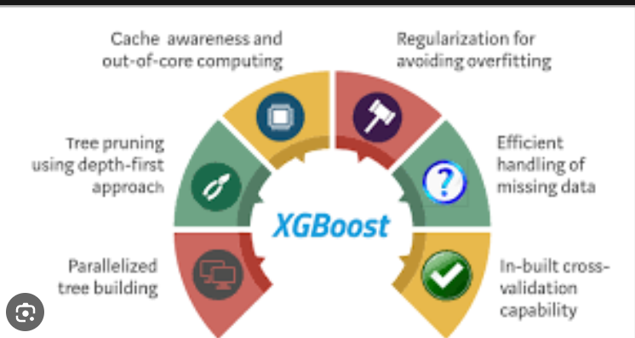
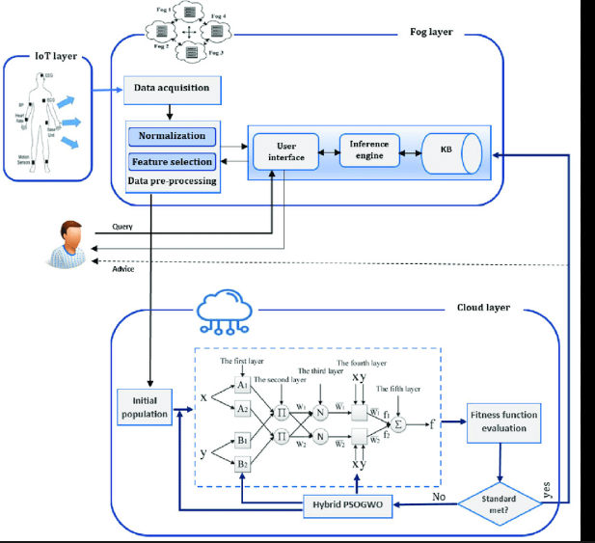
Proposed System
The proposed system for Parkinson's disease detection harnesses the capabilities of XGBoost, a sophisticated and scalable machine learning algorithm renowned for its efficiency in handling intricate relationships within data. XGBoost excels in providing robust predictive performance by amalgamating the strengths of gradient boosting with advanced regularization techniques, rendering it particularly adept for classification tasks, notably Parkinson's disease detection.
The selection of XGBoost is deliberate, driven by its exceptional ability to manage various data challenges. Notably, XGBoost is proficient in handling missing values, accommodating nonlinear relationships inherent in complex medical datasets, and navigating high-dimensional data structures. This adaptability positions XGBoost as a versatile tool, well-suited for the multifaceted nature of clinical data commonly encountered in real-world applications.
Crucially, the algorithm's interpretability is a distinguishing feature, enhancing the understanding of model predictions and facilitating seamless integration into clinical decision-making processes. Its efficiency further underscores its applicability in real-world scenarios, where computational resources and time considerations are pivotal factors.
In summary, the incorporation of XGBoost in the proposed system represents a strategic choice driven by its multifaceted strengths—efficiency, scalability, adaptability to complex data structures, interpretability, and robust predictive performance.

Slide 7
System Requirements
Hardware Requirements:
-CPU : Processor i5 or more
-RAM : 8GB
-Operating System
Software Requirements:
-Jupyter Notebook
-Anaconda Navig
-Python 3.8
Non Functional Requirements
Reliability:
The software should be able to detect the URL tуре accurately,irrespectivec of nо of
attempts.
It should be able to give the faster response as output.
Scalability:
The software should be able to differentiate the class of all the URLs ands should be user
friendly for yielding better results

Slide 8
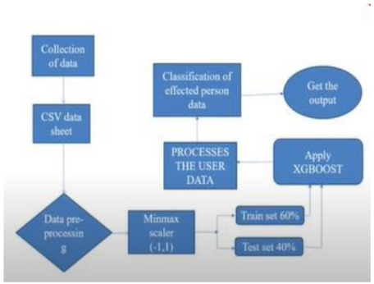
SYSTEM ARCHITECTURE

Slide 9
Layer 1: Data Collection and Preprocessing:
The first step involves acquiring a comprehensive dataset that includes pertinent features derived from clinical assessments of individuals with and without Parkinson's disease. This dataset serves as the foundation for training and evaluating the XGBoost model. Subsequently, rigorous data preprocessing is carried out to handle any missing values, scale features appropriately, and encode categorical variables, ensuring a clean and standardized dataset for model training..
Layer 2: Feature Selection:
Feature selection is a critical phase where the most relevant variables contributing to Parkinson's disease detection are identified. Through this process, redundant or less informative features are excluded, streamlining the dataset to optimize the model's performance. The goal is to retain the most discriminative clinical indicators that significantly influence the predictive capabilities of the XGBoost algorithm.
Layer 3: XGBoost Model Development:
The dataset is divided into training and testing sets, enabling the XGBoost model to undergo rigorous training on a subset of the data. During this phase, hyperparameters are fine-tuned to enhance the model's predictive accuracy. The model learns complex patterns and relationships within the features, aiming to achieve a robust and reliable Parkinson's disease detection capability.
Layer 4: Model Evaluation:
Following the training phase, the XGBoost model is evaluated on a separate testing set to assess its generalization performance. Performance metrics such as accuracy, precision, recall, and F1 score are calculated to gauge the model's effectiveness in correctly identifying cases of Parkinson's disease. Cross-validation techniques may also be employed to ensure the model's stability across diverse subsets of the data.

Slide 10
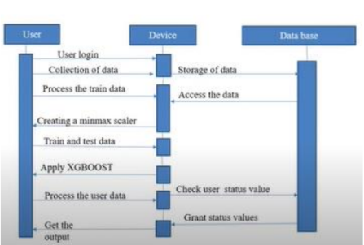
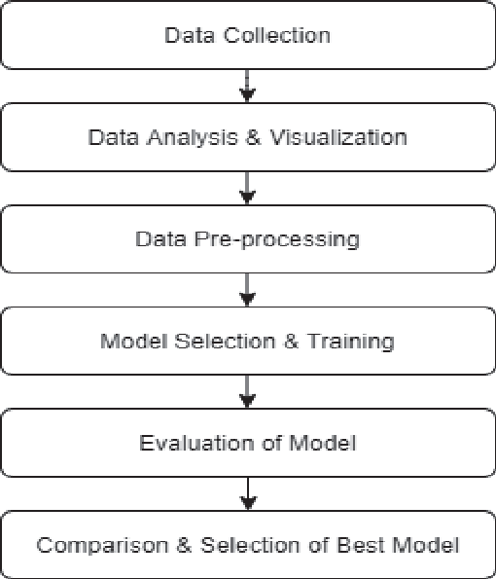
a)Data Flow diagram b)Sequence diagram

Slide 11

Advantage
Optimized Feature Set: The feature selection layer allows for the identification of the most relevant variables, streamlining the dataset. This optimization can lead to improved model performance, interpretability, and reduced computational complexity.
Model Flexibility and Complexity: The use of XGBoost, a powerful algorithm known for its ability to handle complex relationships, provides the model with flexibility to learn intricate patterns in the data. This can lead to high predictive accuracy.
Hyperparameter Tuning: The XGBoost model development layer involves hyperparameter tuning, allowing for the optimization of model parameters to enhance predictive accuracy. This can result in a well-tailored model that performs optimally on the given dataset.
Disadvantage
Data Dependency: The success of the model heavily relies on the quality and representativeness of the dataset. If the dataset is biased or lacks diversity, the model's performance may be limited in real-world scenarios.
Computational Intensity: XGBoost, while powerful, can be computationally intensive, especially during the hyperparameter tuning phase. This might pose challenges in terms of time and resource requirements, particularly for large datasets.
Interpretability Challenges: The complex nature of XGBoost models may hinder interpretability. Understanding the precise reasons behind the model's predictions could be challenging, which may be a concern in certain applications where interpretability is crucial.

Slide 12

Thank You

